Slide 1
Introduction To Web Programming I (CSC 211) Lecture Note 2 How to Structure a Web Page 2 23rd September, 2021

Slide 2
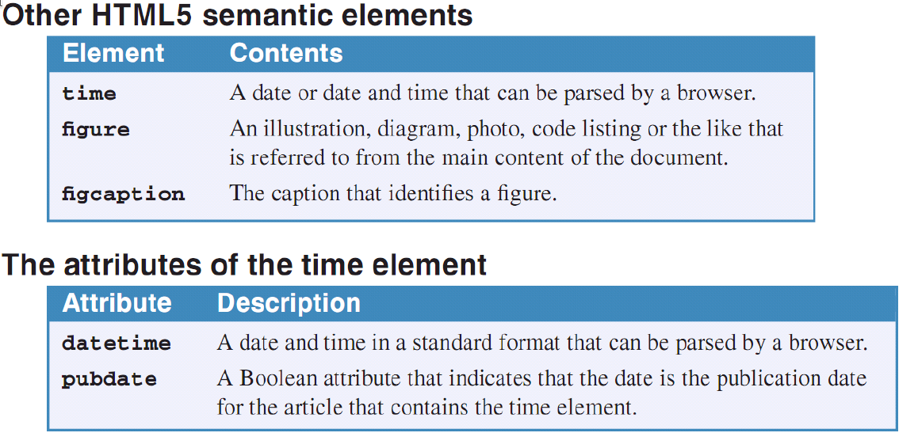
How to code other HTML5 Semantic Elements
Although there are many other HTML5 semantic elements, these are the most useful ones that are currently supported by modern browsers.
Accessibility and SEO guideline
Use the HTML5 semantic elements to indicate the structure of you web pages.
Course Lecturer: Muhammad S. Ali
Thursday, September 23, 2021
2

Slide 3
A time element
<p>Next year’s admission will probably be on <time datetime=”2022-3-23”>Monday 23rd</time>.</p>
The figure and figcaption elements
<figure>
<code>
var today = new Date(); <br>
document.writeln( today.getFullYear() ); <br><br>
</code>
<figcaption>
JavaScript code for getting the year from the current date
</figcaption>
Course Lecturer: Muhammad S. Ali
Thursday, September 23, 2021
2

Slide 4
When and how to code div and span elements
div is a block element for structuring a web page – it lets you divide a page into divisions that can be formatted and positioned with CSS.
Before HTML5, div elements were used to define divisions within the body of a document. Now, the HTML5 semantic elements will be replacing div elements.
span is an inline element for formatting text – it lets identify text that can be formatted with CSS.
Before HTML5, span elements were used to identify portions of text that you could apply formatting to. Today, a better practice is to use the block elements for special types of text (pre, blockquote, address, e.t.c.) and inline elements for for formatting text (i, b, sub, sup, br, e.t.c) and inline elements for identifying content such as (abbr, cite, code, dfn, em, kbd, q, samp, strong, var, e.t.c) to identify content and use the CSS to format that content.
Course Lecturer: Muhammad S. Ali
Thursday, September 23, 2021
4

Slide 5
A page that’s structured with div and span elements
<body>
<div id=”header”>
<h1>San Joaquin Valley Town Hall</h1>
</div>
<div id=”main”>
<p><span id=”welcome”>Welcome to San Joaquin Valley Town Hall.</span>
We have some fascinating speakers for you this season!</p>
</div>
<div id=”footer”>
<p>&copy; Copyright 2021 CSC 211 – Intro to Web Programming I</p>
</div>
</body>
Course Lecturer: Muhammad S. Ali
Thursday, September 23, 2021
5

Slide 6
How to links, lists, and images
How to code absolute and relative URLs
When you code an absolute URL, you code the complete URL including the domain name for the site. Absolute URLs let you display pages at other websites.
When you code relative URL, you base it on the current folder, which is the folder that contains the current page.
A root-relative path is relative to the root folder of the website. It always starts with a slash. Then, to go down one subfolder, you can code the subfolder name and a slash. To go down two subfolders, you can code a second subfolder name and a slash. And so on.
A document-relative path is relative to the folder the current document is in. then, to go down one subfolder, you can code the subfolder name followed by a slash. To go down two subfolders, you can code a second subfolder name followed by another slash. And so on.
You can also go up in a document-relative path. To go up one level from the current folder, you can code two periods and a slash. To go up two levels, you code two periods and a slash followed by two more periods and a slash. And so on
Course Lecturer: Muhammad S. Ali
Thursday, September 23, 2021
6

Slide 7
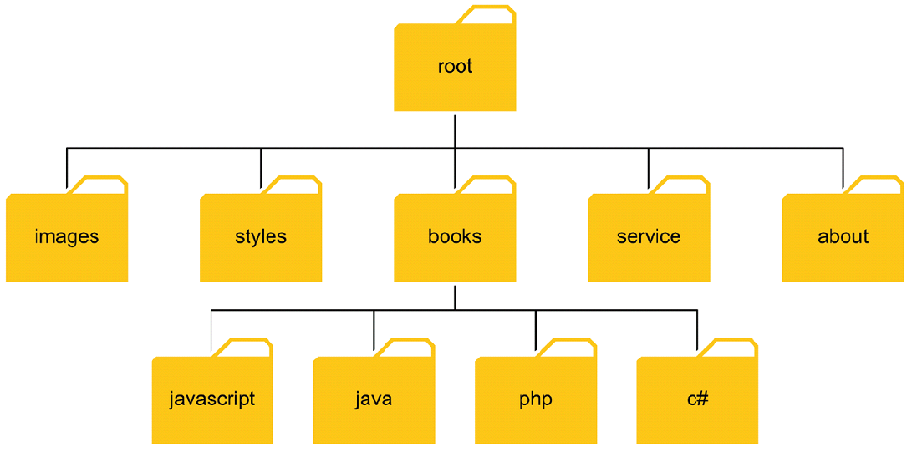
A simple website directory structure

Slide 8
Examples of absolute and relative URLs
Absolute URLs
https://www.fud.edu.ng/index.html
https://www.jsiit.edu.ng/hostels/booking.html
Root-relative paths
/login.html (refers to root/login.html)
/images/logo.gif (refers to root/images/logo.gif)
Document-relative paths that navigate down from the root folder
images/logo.gif (referes to root/images/logo.gif)
books/php/overview.html (referes to root/books/php/overview.html)
Document-relative paths that navigate up from the root/books folder
../index.html (refers to root/index.html)
../images/logo.gif (refers to root/images/logo.gif)
Course Lecturer: Muhammad S. Ali
Thursday, September 23, 2021
8

Slide 9
How to code links
Most web pages contain links that go to other web pages or web resources.
To code a link, you use the anchor tag element (<a>)
The <a> is an inline element that create a link that loads another web page. The href attribute of this element identifies the page to be loaded.
The text content of a link is underlined by default to indicate that it is clickable.
If a link has not been visited, it is displayed in blue. If it has been visited, it is displayed as purple. You can change these defaults using CSS.
If the mouse hovers over a link, the cursor is changed to a hand with the finger pointed.
Examples
A link to a web page in the same folder
<p>Go view our <a href=”courses.html”>Courses list</a>.</p>
A link to a web page in a subfolder of the parent folder
<p>Read about the <a href=”../company/services.html”>services we provided</a>.</p>
A link to a web page based on the root folder
<p>View your <a href=”/orders/cart.html”>Shooping cart</a>.</p>
Course Lecturer: Muhammad S. Ali
Thursday, September 23, 2021
9

Slide 10
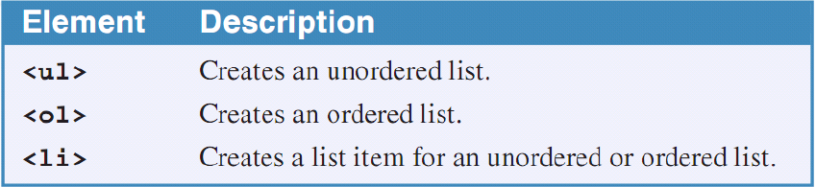
How to code lists
There are two basic types of lists: ordered lists and unordered lists.
By default, unordered lists are displayed as bulleted list and an ordered list is displayed as a numbered list.
You can code li (list item) element for each of the two types of the lists to create each item in the lists.
When you work with the li element, you should be aware that it can contain a text, inline elements, or block elements. For example, an li element can contain an <a> element that defines a link. In fact, it is a best practice to code a series of links within an unordered list.
Elements that create ordered and unordered lists
Course Lecturer: Muhammad S. Ali
Thursday, September 23, 2021
10

Slide 11
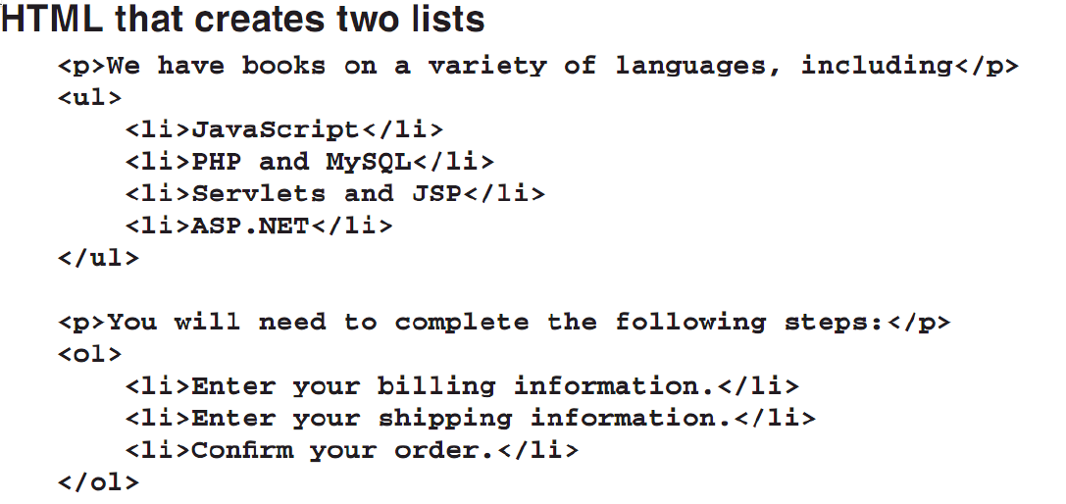
Course Lecturer: Muhammad S. Ali
Thursday, September 23, 2021
<number>

Slide 12
How to include images
Images are an important part of most web pages. To display image, you can use the img element.
The img element is an inline element that is used to display an image that is identified by the src attribute.
The height and width attributes can be used to indicate the size of an image so the browser can allocate the correct amount of space on the page. These attributes can also be used to size an image, but it is usually better to use an image editor to do the sizing.
JPEG (Joint Photographic Experts Group) files commonly use the JPG extension and are typically used for photographs and scan. GIF (Graphic Interchange Format) files are typically used for small illustrations and logos. And PNG (Portable Network Graphics) files combine aspects of JPEG and GIF files.
Above image formats are supported by most browsers.
For images with useful contents, always code an alt attribute that describes the image. For images that are used for decoration, code the alt attribute with no value (“”).
Course Lecturer: Muhammad S. Ali
Thursday, September 23, 2021
12

Slide 13
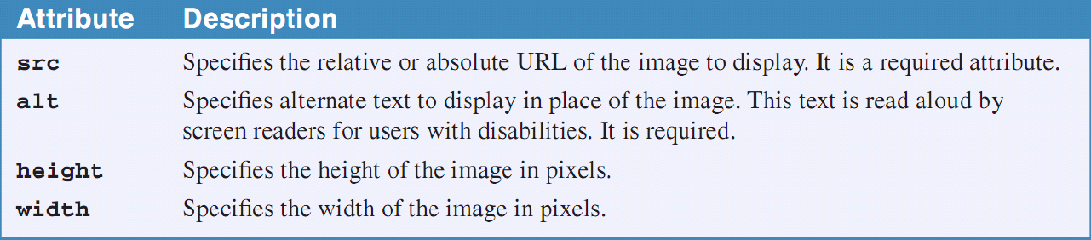
How to code character entities
Attributes of the <img> element
Example
<img src=”images/school/fudlogo.gif” alt=”FUD Logo” height=75”>
<h1>Faculty of Computing, Federal University Dutse</h1>
Course Lecturer: Muhammad S. Ali
Thursday, September 23, 2021
13

Slide 14
SAMPLE SIMPLE WEBSITE

